Slide 1
Ggplot2 and interactive graphics with R
Christophe Ladroue
SECTION 05
VIDEO 03
Customizing the color palette
for categorical variables
www.PacktPub.com

Slide 2
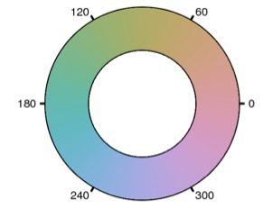
HCL color-space: hue, chroma, luminance
Ggplot2 defaults:
Evenly spaced hues
Constant chroma
Constant luminance
Source: hclcolor.com

Slide 3
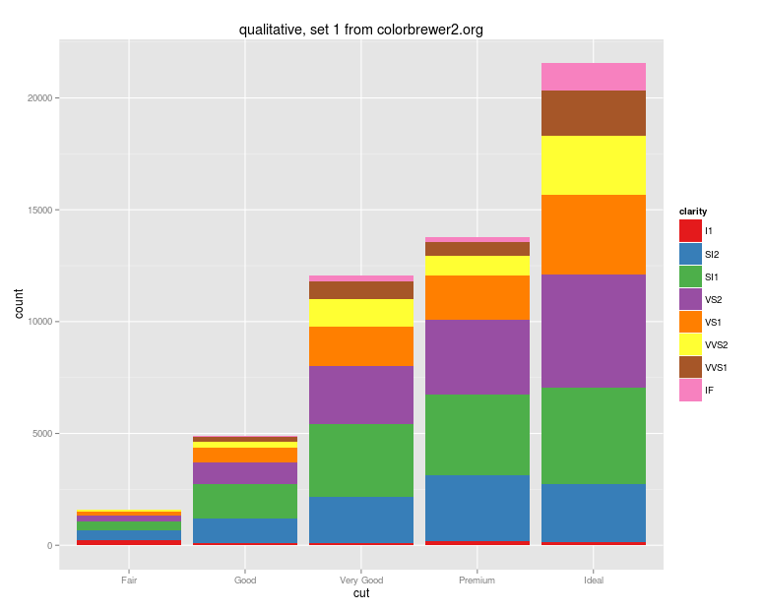
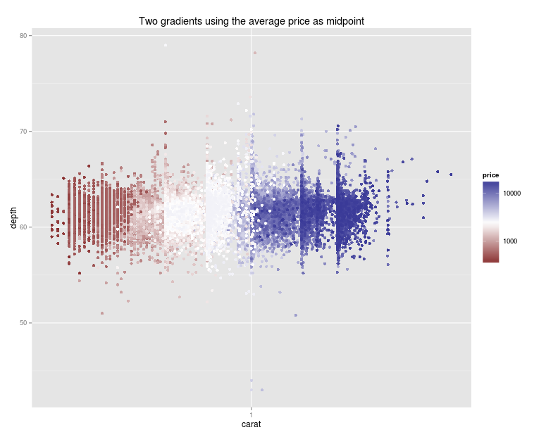
In this video we took a look at
how the colors for categorical variables are chosen by default.
how to set user-defined colour palettes.
how to use an existing collections of quality palettes easily.
Next: colors for continuous variables

